Slide 1
IoT-Based Smart Home Automation System
MATHANKUMAR S
22CDL124

Slide 2
Introduction
This project focuses on automating household appliances using IoT.
Appliances can be controlled via mobile apps, web interface, or voice assistants.
Reduces manual work and enables remote operation.

Slide 3
Objective
Develop a smart home automation system.
Enable appliance control from anywhere via internet.
Integrate voice assistants like Google Assistant and Alexa.

Slide 4
Components Used
NodeMCU (ESP8266 / ESP32)
Relay Module
Light Bulb
Jumper Wires, Breadboard
Google Assistant / Alexa
Android Mobile
Power Supply

Slide 5
Working Process
User gives voice command or mobile app instruction.
Command sent via cloud (Blynk/Firebase/MQTT).
NodeMCU receives command and activates the relay.
Appliance (e.g., bulb) turns ON/OFF.

Slide 6
Output Image
Light turns ON by voice/mobile command
Output verified through real-time feedback

Slide 7
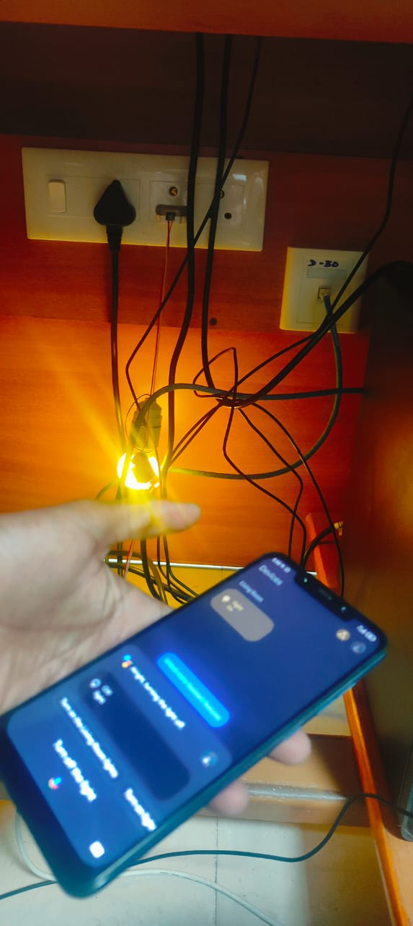

Slide 8
Benefits
Remote control of devices
Saves energy and time
Secure and real-time communication
Supports multiple devices

Slide 9
Conclusion
A successful demo of IoT-based smart home setup.
Scalable for more devices.
Can be enhanced with sensors and analytics.

